Slide 1


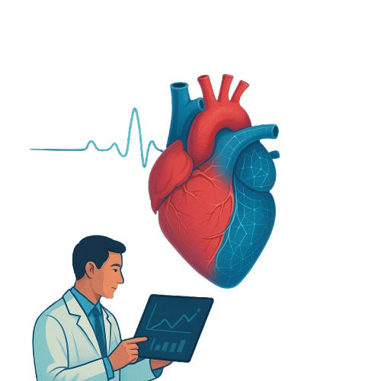

Heart Disease Risk
Prediction
Healthcare Predictive Analytics
ONL2_AIS4_S2 || Data Scientist
Team 8
Supervision Eng / Mahmoud Khorshid

Slide 2
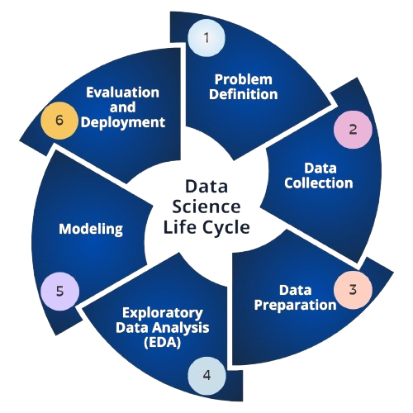

Data Science Process

Slide 3

📊 Sudden Heart Disease Incidence Rates (Globally)
♦ Sudden Cardiac Death (SCD)
• Accounts for about 15% to 20% of all deaths worldwide.
• More frequent in men and in people aged 45 and older, but it can also occur in young adults
♦ United States
•Around 350,000 cases of sudden cardiac arrest occur annually.
•The survival rate is low — only 10% to 12% survive.
♦ Arab Countries
•Heart diseases account for over 35% of total deaths in some countries.
•Sudden cardiac deaths in young individuals are increasing due to lifestyle factors (like obesity, diabetes, and lack of physical activity).
Introduction

Slide 4

Problem
Definition
1
Heart disease is the leading cause of death globally, but early detection can save lives. Our project aims to simplify heart health assessments using predictive analytics powered by simple, everyday health questions. Instead of undergoing complex medical tests right away, users can answer a short series of Yes/No questions related to common symptoms, lifestyle habits, and risk factors. By analyzing the responses with machine learning algorithms, our system estimates the user's risk level for heart disease and provides early warnings — helping individuals seek timely medical advice.
⏰ Fast & Accessible: just quick, easy answers.
💻 Data-Driven: Uses healthcare data and predictive models.
🧑‍⚕️ Early Detection: Identifies high-risk individuals before symptoms become severe.
🌍 Scalable Impact: Useful in clinics, remote health programs, or even personal health apps.

Slide 5


Data
Collection
2
To support our idea, we conducted extensive research and analysis to find the most relevant and meaningful data for predicting heart disease. Our goal was to keep things simple.
Finally, we found the appropriate Data on Kaggle
Heart_Disease_Risk_Dataset

Slide 6

Data
Understanding
3
1
Chest_Pain
Discomfort or pain in the chest area.
2
Shortness_of_Breath
Difficulty breathing or feeling out of breath
3
Fatigue
Persistent tiredness or lack of energy.
4
Palpitations
A feeling that the heart is pounding, fluttering, or beating irregularly
5
Dizziness
6
Swelling
Feeling lightheaded or faint
Edema, especially in legs, ankles, or feet
7
Pain_Arms_Jaw_Back
Discomfort radiating to arms, jaw, or back.
8
Cold_Sweats_Nausea
Sudden sweating and feeling nauseated

Slide 7
Data
Understanding
3
9
High_BP (High Blood Pressure)
Hypertension; elevated pressure in arteries.
10
High_Cholesterol
Elevated levels of LDL (bad) cholesterol
11
Diabetes
Chronic high blood sugar levels
Smoking
12
Use of tobacco products
13
Obesity
Excessive body weight or BMI >30
Sedentary_Lifestyle
14
Edema, especially in legs, ankles, or feet
15
Family_History
Discomfort radiating to arms, jaw, or back.
Chronic_Stress
16
Long-term emotional or psychological stress

Slide 8

Data
Exploration
4
01
Data types and non-null counts
03
Missing Values
05
Info
isnull
Shape
Describe
Value Counts
Data Dimensions
Statistical Analysis
Distribution of the target variable
02
04

Slide 9



5
Exploratory Data Analysis
Objective: Understand feature distributions and their relationship with heart disease risk.
Focus: Binary feature prevalence, correlation, and age-based trends.
Tools used:
Count plots
Stacked bar charts
Correlation heatmap
Boxplot and histograms (Age vs Heart Risk)

Slide 10


Binary Feature Distribution
Calculated count of 0s and 1s in binary variables.
Computed percentage of 1s per feature.
Identified which risk factors are most common.

Slide 11

Visualizing Binary Features
Used Seaborn countplot for visualizing distribution.
Example: How many smokers vs non-smokers.
Insight: Imbalance or skew in health factors.

Slide 12

Binary Features vs Heart Risk
Created stacked bar charts to show:
Proportion of heart disease risk per category (0/1).
Helps identify strong categorical predictors (e.g., Hypertension).

Slide 13

Correlation Insights
Computed correlation of all features with Heart_Risk.
Visualized using a heatmap:
Shows strength & direction of relationships.
Key Insight: Age and health behaviors have strong correlation with risk.

Slide 14


Age-Based Trends
Finding:
Higher age correlates with greater heart disease risk.
Boxplot:
Age distribution for people with and without heart risk.
Histogram:
Age overlay for both classes.

Slide 15
Data
Preprocessing
6
01
05
Separate Features and Target
02
Split the Dataset

Slide 16

7
Model Training
Goal: Predict heart disease risk using ML models.
Models used:
Logistic Regression
K-Nearest Neighbors (KNN)
Decision Tree
Random Forest
Naive Bayes
Support Vector Machine (SVM)
Each model was:
Trained on 80% of the data (X_train, Y_train)
Tested on 20% (X_test, Y_test)
Evaluated using Accuracy, ROC AUC, and F1-score

Slide 17


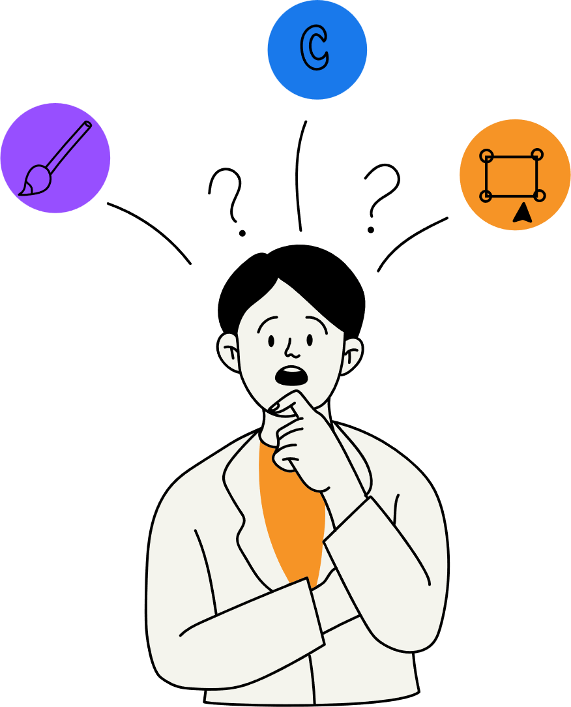

Model Accuracy Comparison
Model
Key Traits
Accuracy
Logistic Regression
Fast, linear, less complex
~99.14%
Naive Bayes
Assumes feature independence
~99.9%
SVM
Good for high-dimensional data
~99.6%
KNN
Sensitive to irrelevant features
~98.96%
Decision Tree
Sensitive to irrelevant features
~98.12%
Random Forest
Ensemble, robust, handles non-linearity
~99.9%

Slide 18
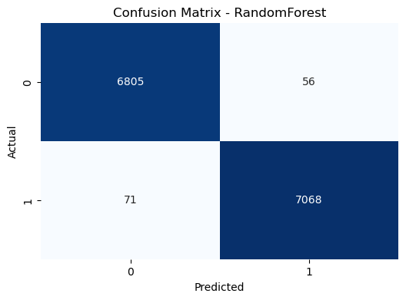
8
Evaluation
Measures the percentage of correct predictions
01
03
Confusion Matrix
ROC Curve & AUC Score
Accuracy Score
Classification Report
Measures the percentage of correct predictions
02
Precision
Recall (Sensitivity)
F1-score
04

Slide 19

Model
Optimization
9
Model accuracy
Model generalization (ability to work well on new data)
Overfitting or underfitting
Some models perform better when features are on the same scale.
01
03
Scaling Features
Impact
Goal
Hyperparameters
To improve the performance of your machine learning model by tuning its hyperparameters — the settings that control how the model learns.
02
Number of trees in a Random Forest
Maximum tree depth
Learning rate in Gradient Boosting
Regularization strength in logistic regression
04
Grid Search

Slide 20
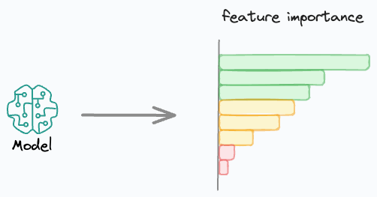
Feature Importance
10
0
Trust
Focus
Feature selection
To understand which features, contribute most to the predictive model.
01
03
Goal
Why This Matters in Healthcare
What Is Feature Importance?
How Random Forest Calculates It
How much each feature reduces uncertainty (impurity) in decision trees during training
02
04
Builds many trees
Tracks how much each feature helps reduce impurity
Averages this over all trees to get the overall importance.

Slide 21

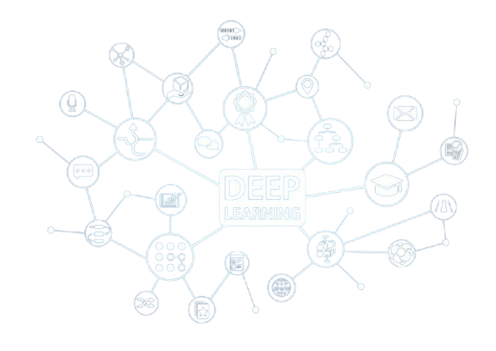

Model Optimization

Slide 22

DNN (Deep Neural Network)
A Deep Neural Network is a type of artificial neural network with multiple layers between the input and output. These networks are capable of learning complex patterns from large datasets and are commonly used for tasks like classification, regression, image recognition, and natural language processing.
Structure of a DNN
○ Input Layer – Takes in the input features.
○ Hidden Layers – Multiple layers where each neuron is connected to the next layer, allowing learning of abstract representations.
○ Output Layer – Provides the final prediction or classification.

Slide 23
DNN (Deep Neural Network)
Optimization Area
○ Loss Function: binary_crossentropy measures how far predictions are from true binary labels.
○ Backpropagation: TensorFlow automatically computes gradients of the loss w.r.t. weights.
○ Optimizer: AdamW updates weights to reduce the loss, balancing learning rate and weight decay for better generalization.
○ Epochs: The dataset is iterated multiple times to progressively minimize the error.

Slide 24

11
Deployment
Streamlit Deployment
Streamlit Deployment

Slide 25
11
Deployment
Streamlit Deployment
Streamlit Deployment

Slide 26
11
Deployment
Streamlit Deployment
Streamlit Deployment

Slide 27

Team Members
1
Abdelrahman Elsayed Mohamed
2
Abdallah Mohamed Abdallah
3
Mazen Mostafa Abo-ElYazeed
4
Mazen Ehab Gamal
5
Omar Ayman Mohamed
6
Seif El-Eslam Mohamed Yahia

Slide 28
Team Members
Abdelrahman Elsayed Mohamed
1
Abdallah Mohamed Abdallah
2
Mazen Mostafa Abo-ElYazeed
3
Mazen Ehab Gamal
4
Omar Ayman Mohamed
5
Seif El-Eslam Mohamed Yahia
6

Slide 29



